Slide 1


A Heuristic Algorithm for Scheduling Aerial Resources for the Extinction of Large-scale Wildfires
MASTER THESIS No. 3010
DEFENSE PRESENTATION
Luka Mesarić
Mentor: prof. Lea Skorin-Kapov
Co-mentor: assoc. prof. Nina Skorin-Kapov
Zagreb, June 28, 2022

Slide 2
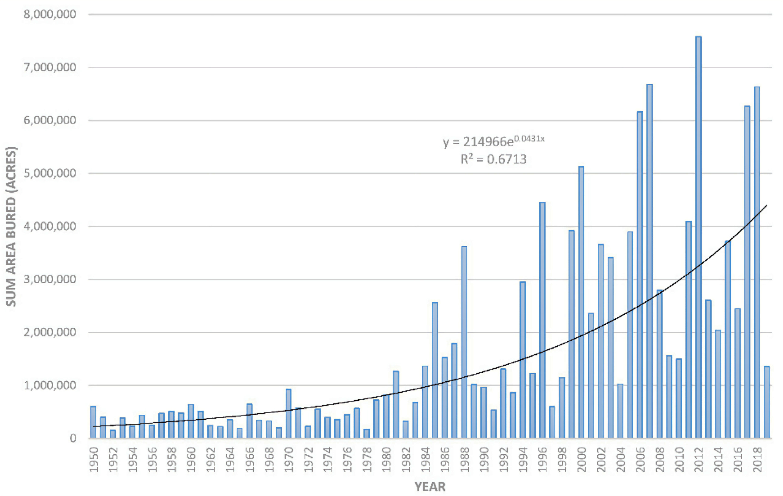
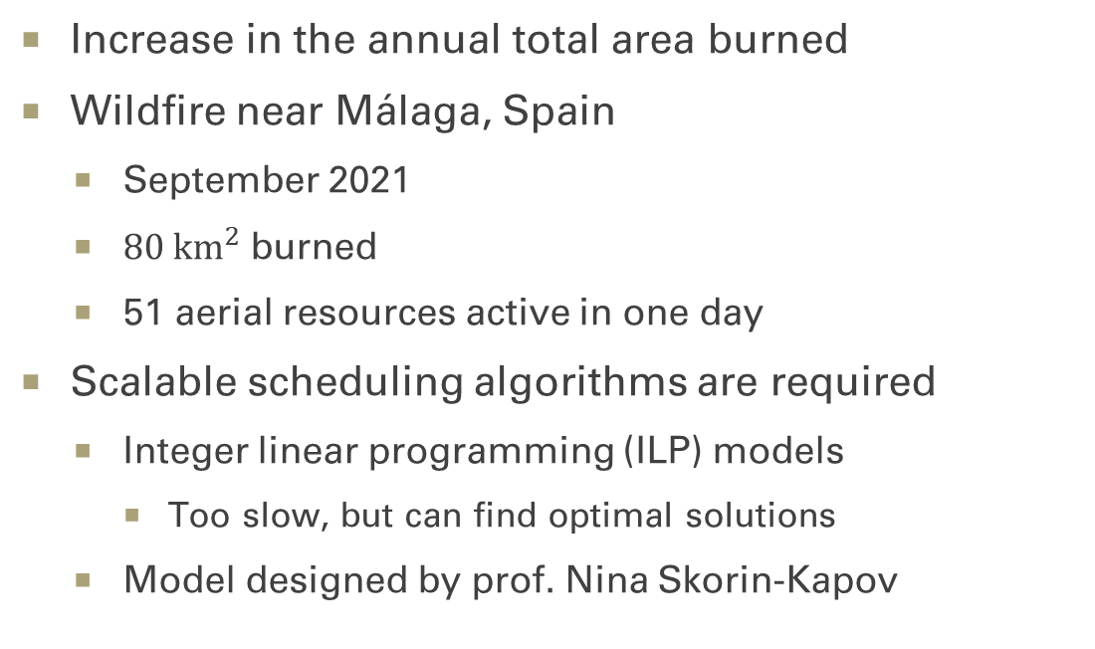
Motivation
Increase in the annual total area burned
Wildfire near Málaga, Spain
September 2021
$80 {\text{km}}^{2}$ burned
51 aerial resources active in one day
Scalable scheduling algorithms are required
Integer linear programming (ILP) models
Too slow, but can find optimal solutions
Model designed by prof. Nina Skorin-Kapov
The annual total area burned in the western United States between 1950 and 2019 [1]

Slide 3
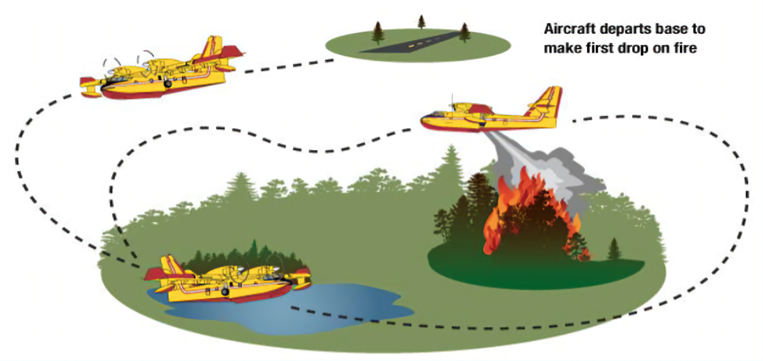
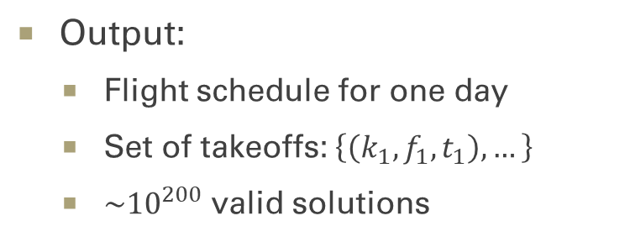
The Problem
Discrete time – 45 slots of 20-minute intervals
Multiple fire fronts
Helicopters and airplanes
Capacity, availability, drops per hour, rest time, etc.
Attempt to meet the target water content
Large-scale wildfires
More than 20 resources
Lasting several days
Obey Spanish regulation of civil aviation
Output:
Flight schedule for one day
Set of takeoffs: $\left\{\left(k_{1}, f_{1}, t_{1}\right), …\right\}$
${\sim 10}^{200}$ valid solutions
A flight path which includes takeoff and repeated filling and dropping of water [2]

Slide 4
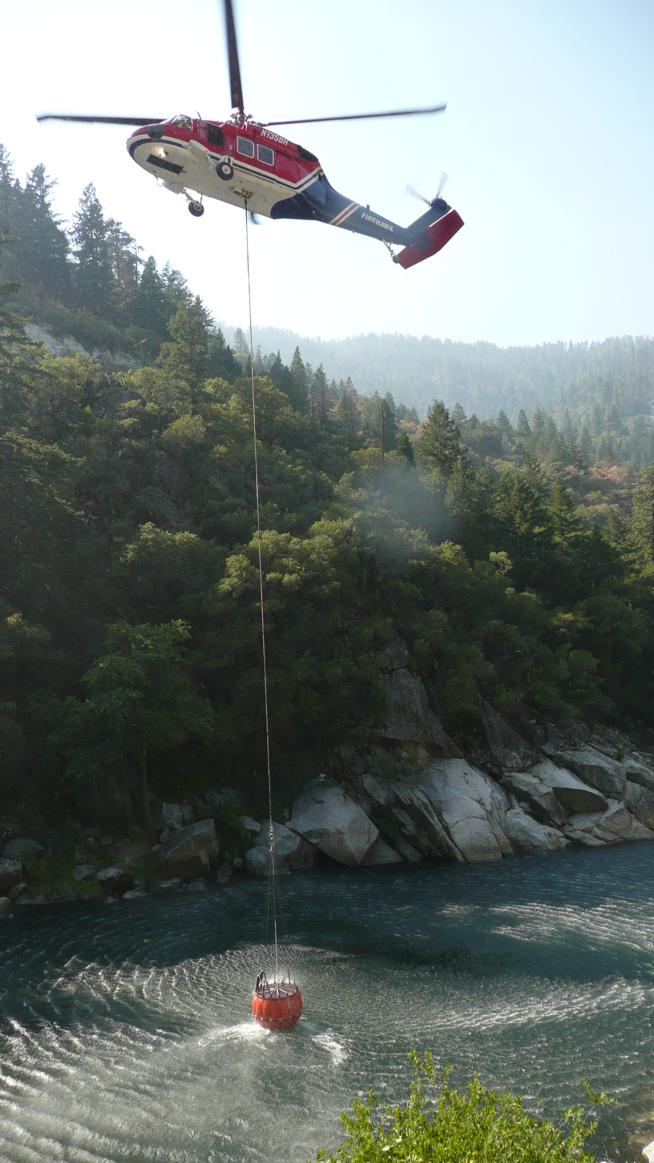
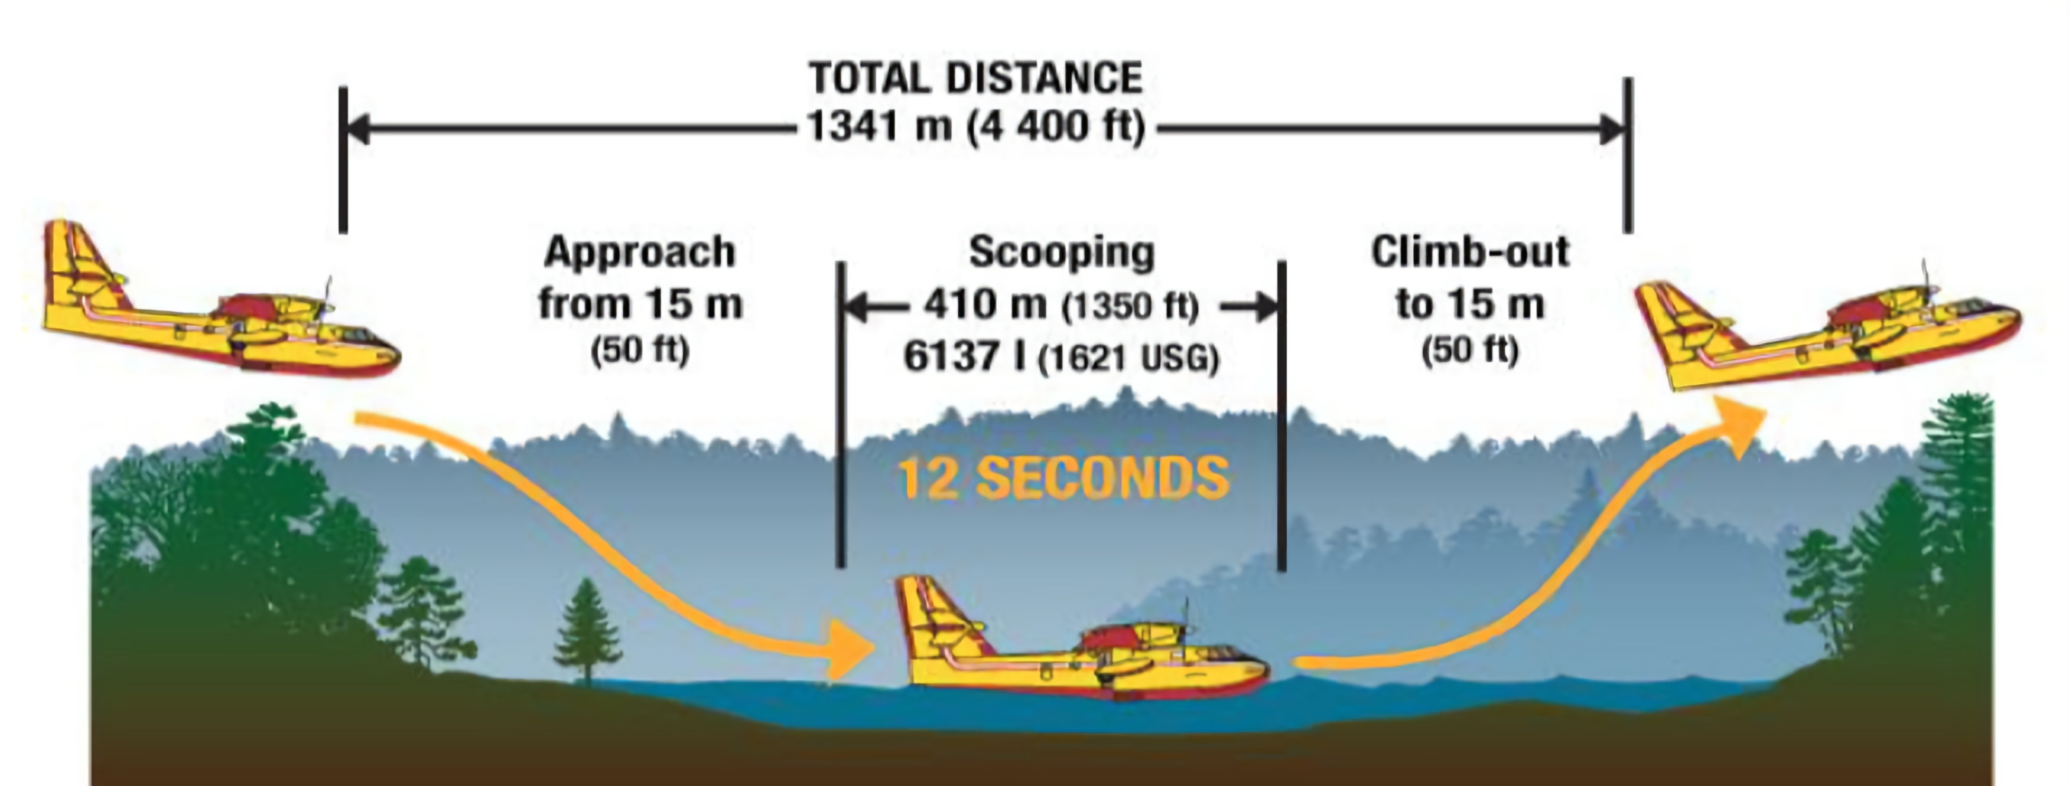
Constraint Examples
Helicopters and airplanes cannot fly at the same front at the same time
Different flight paths
Airplanes cannot be assigned to some fronts
Inaccessible water refilling points
Photograph by Hustvedt, CC BY-SA 3.0 license
An illustration of water scooping by an amphibious aircraft [2]

Slide 5
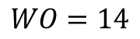
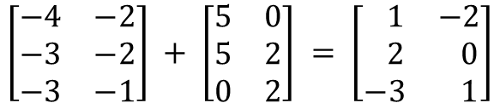
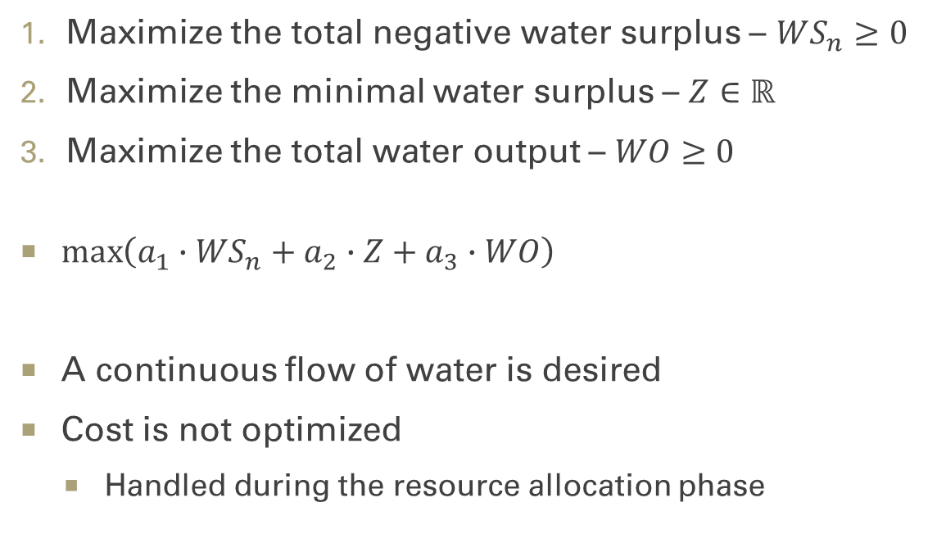
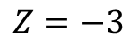
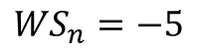
Objectives
Maximize the total negative water surplus – $WS_{n}≥0$
Maximize the minimal water surplus – $Z∈ℝ$
Maximize the total water output – $WO≥0$
$\max\left(a_{1}∙{WS}_{n}+a_{2}∙Z+a_{3}∙WO\right)$
A continuous flow of water is desired
Cost is not optimized
Handled during the resource allocation phase
Targets
Dropped
Surplus
$$\left[\begin{matrix}−4 & −2 \\ −3 & −2 \\ −3 & −1\end{matrix}\right] + \left[\begin{matrix}5 & 0 \\ 5 & 2 \\ 0 & 2\end{matrix}\right] = \left[\begin{matrix} 1 & −2 \\ 2 & 0 \\ −3 & 1\end{matrix}\right]$$
$$WO=14$$
$$Z=−3$$
$${WS}_{n}=−5$$

Slide 6
Heuristic Algorithm
GRASP
Randomized greedy algorithm
Restricted candidate list (RCL)
Local search
Large neighborhood search
Implicit neighborhood via destroy and repair methods (DFS)
Simulated annealing
Accept non-improving neighbors

Slide 7
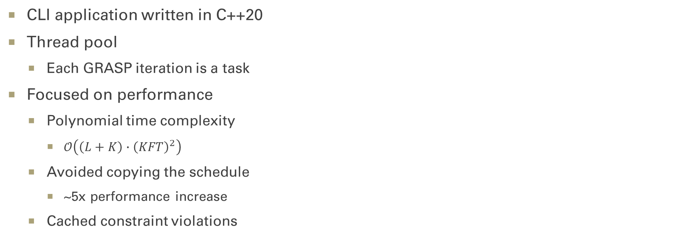
Implementation
CLI application written in C++20
Thread pool
Each GRASP iteration is a task
Focused on performance
Polynomial time complexity
$𝒪\left(\left(L+K\right)∙{\left(KFT\right)}^{2}\right)$
Avoided copying the schedule
~5x performance increase
Cached constraint violations

Slide 8
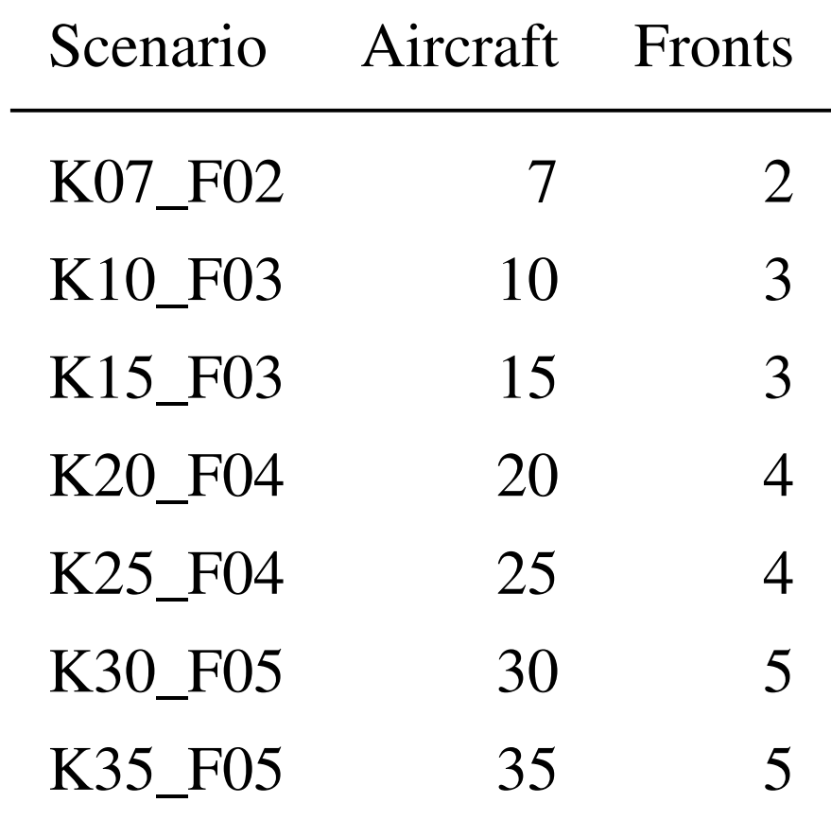
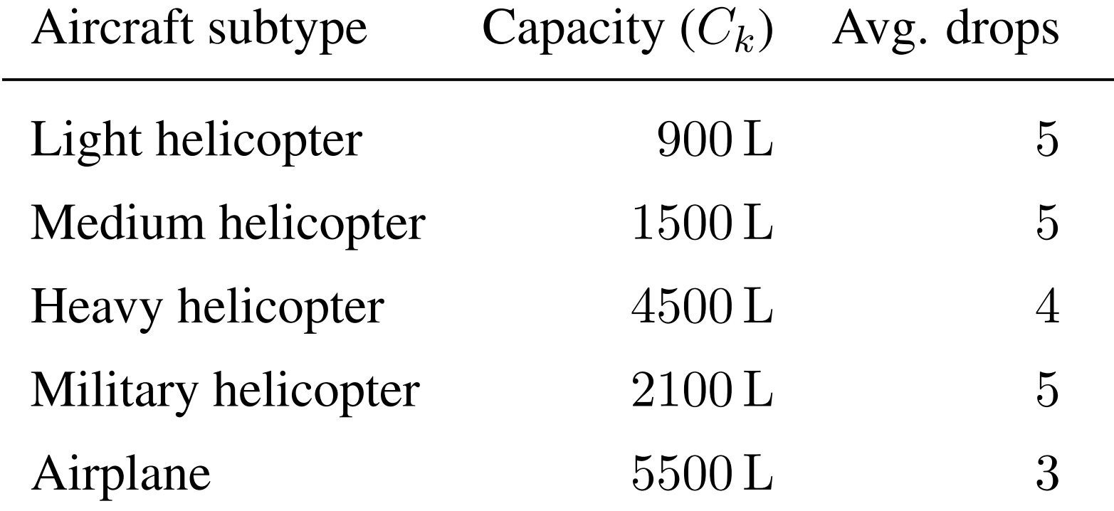
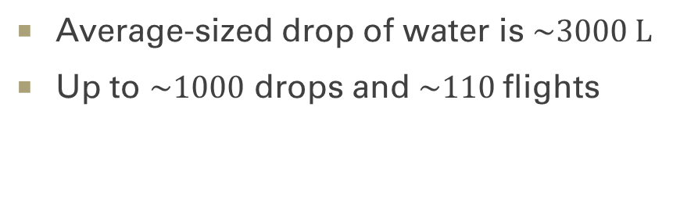
Test Scenarios
420 instances divided into 84 scenarios
Seven scenario sizes
Four distributions of the target water content over time and fronts
Average-sized drop of water is $\sim 3000 \text{L}$
Up to $\sim 1000$ drops and $\sim 110$flights

Slide 9
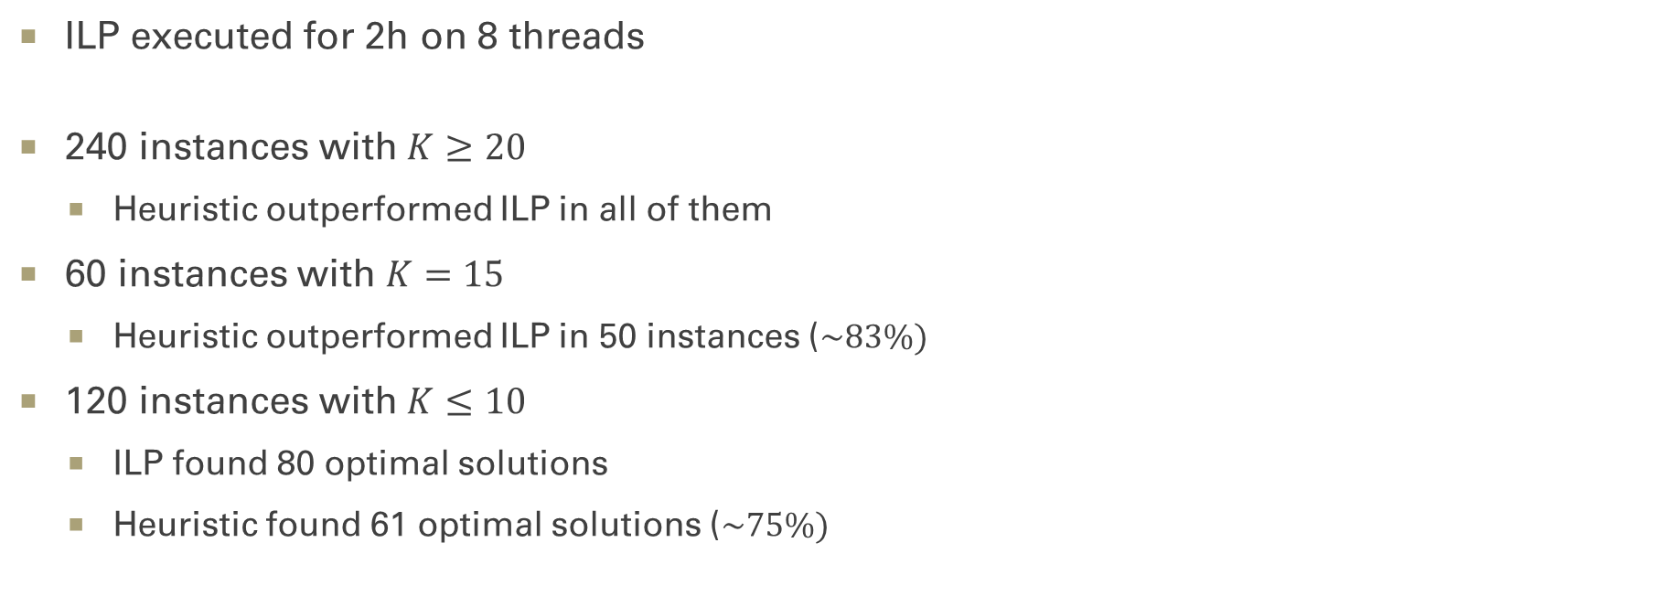
Results (1/2)
ILP executed for 2h on 8 threads
240 instances with $K≥20$
Heuristic outperformed ILP in all of them
60 instances with $K=15$
Heuristic outperformed ILP in 50 instances ($\sim 83\%)$
120 instances with $K≤10$
ILP found 80 optimal solutions
Heuristic found 61 optimal solutions ($\sim 75\%)$

Slide 10
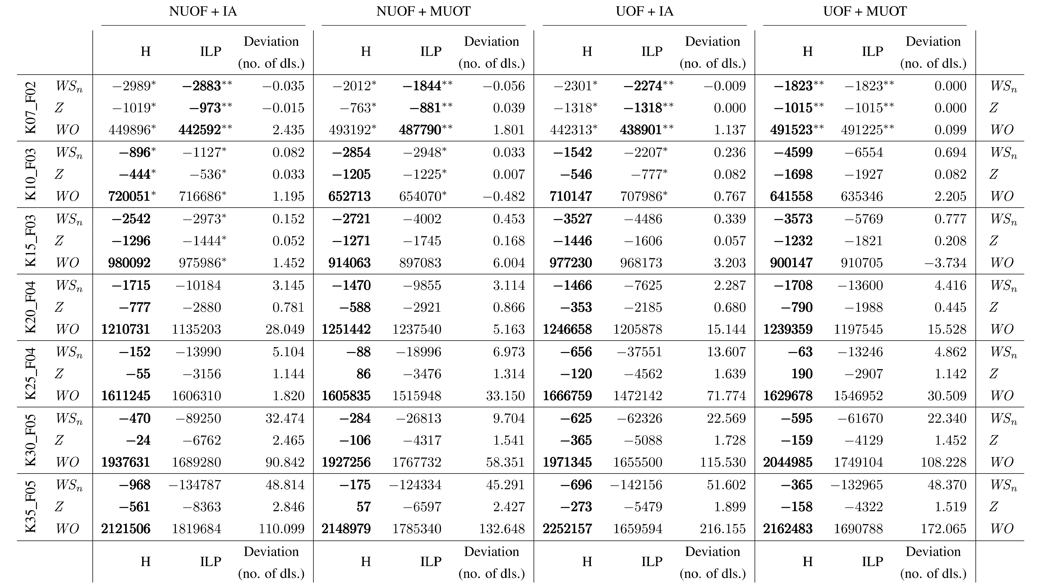

Slide 14
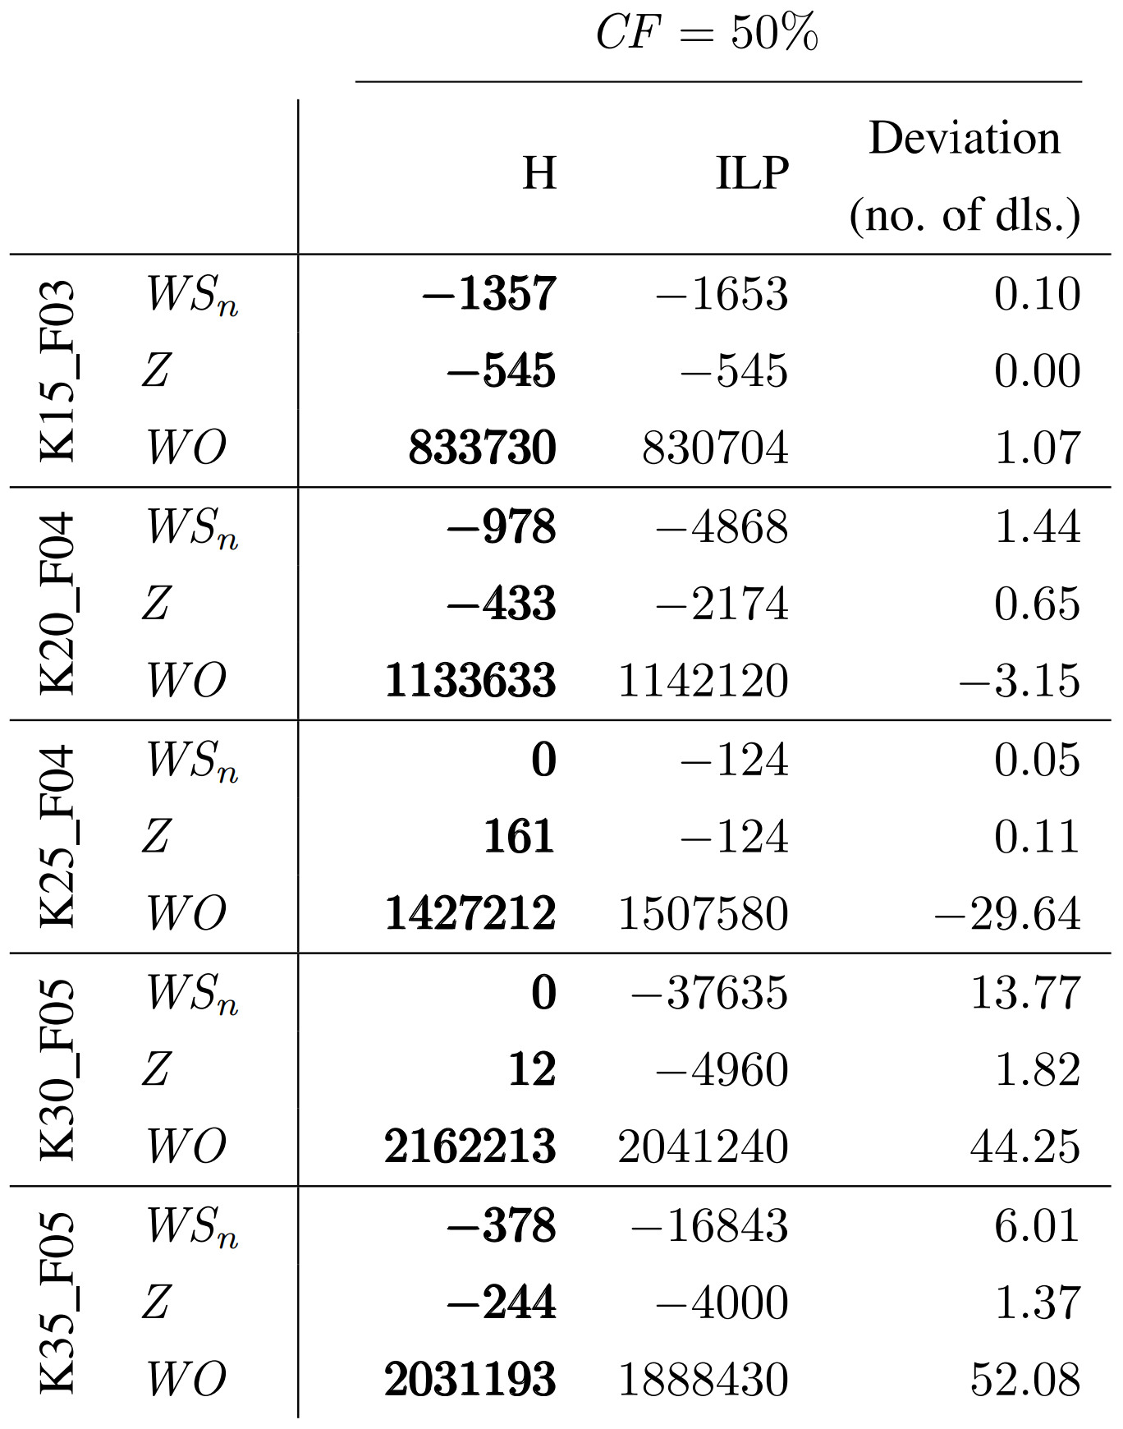
Results (2/2)
Linear solver executed for 6h on 16 threads
Effectively 6x longer execution
Execution was not extended for the heuristic algorithm

Slide 15
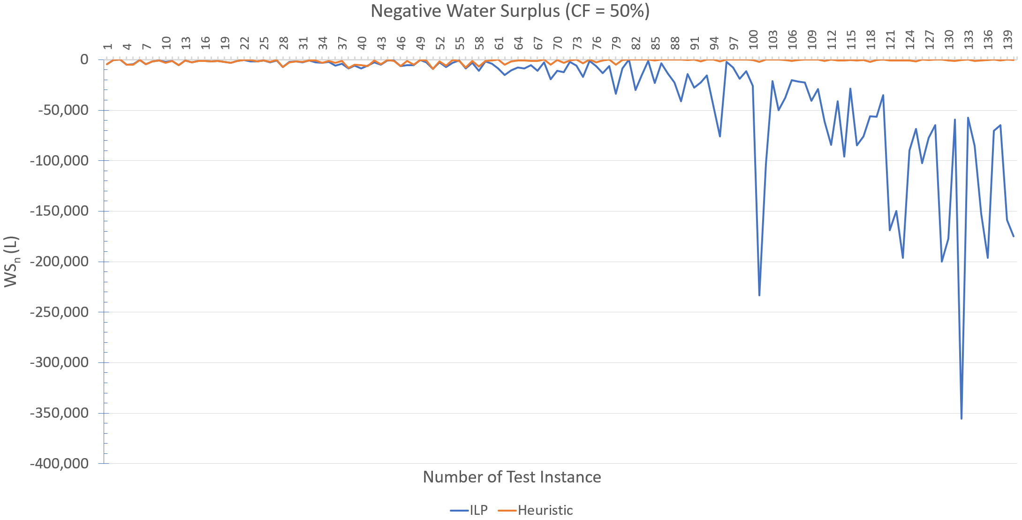
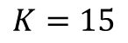
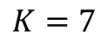
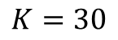
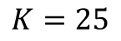
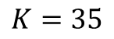
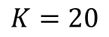
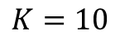
$$K=35$$
$$K=7$$
$$K=10$$
$$K=15$$
$$K=20$$
$$K=25$$
$$K=30$$

Slide 16
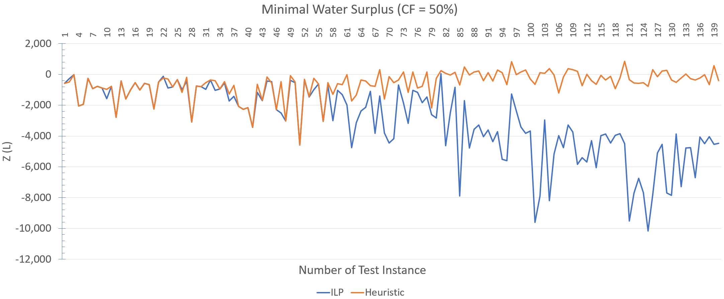
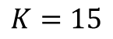
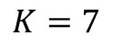
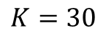
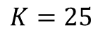
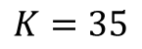
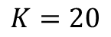
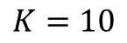
$$K=7$$
$$K=10$$
$$K=15$$
$$K=20$$
$$K=25$$
$$K=30$$
$$K=35$$

Slide 17
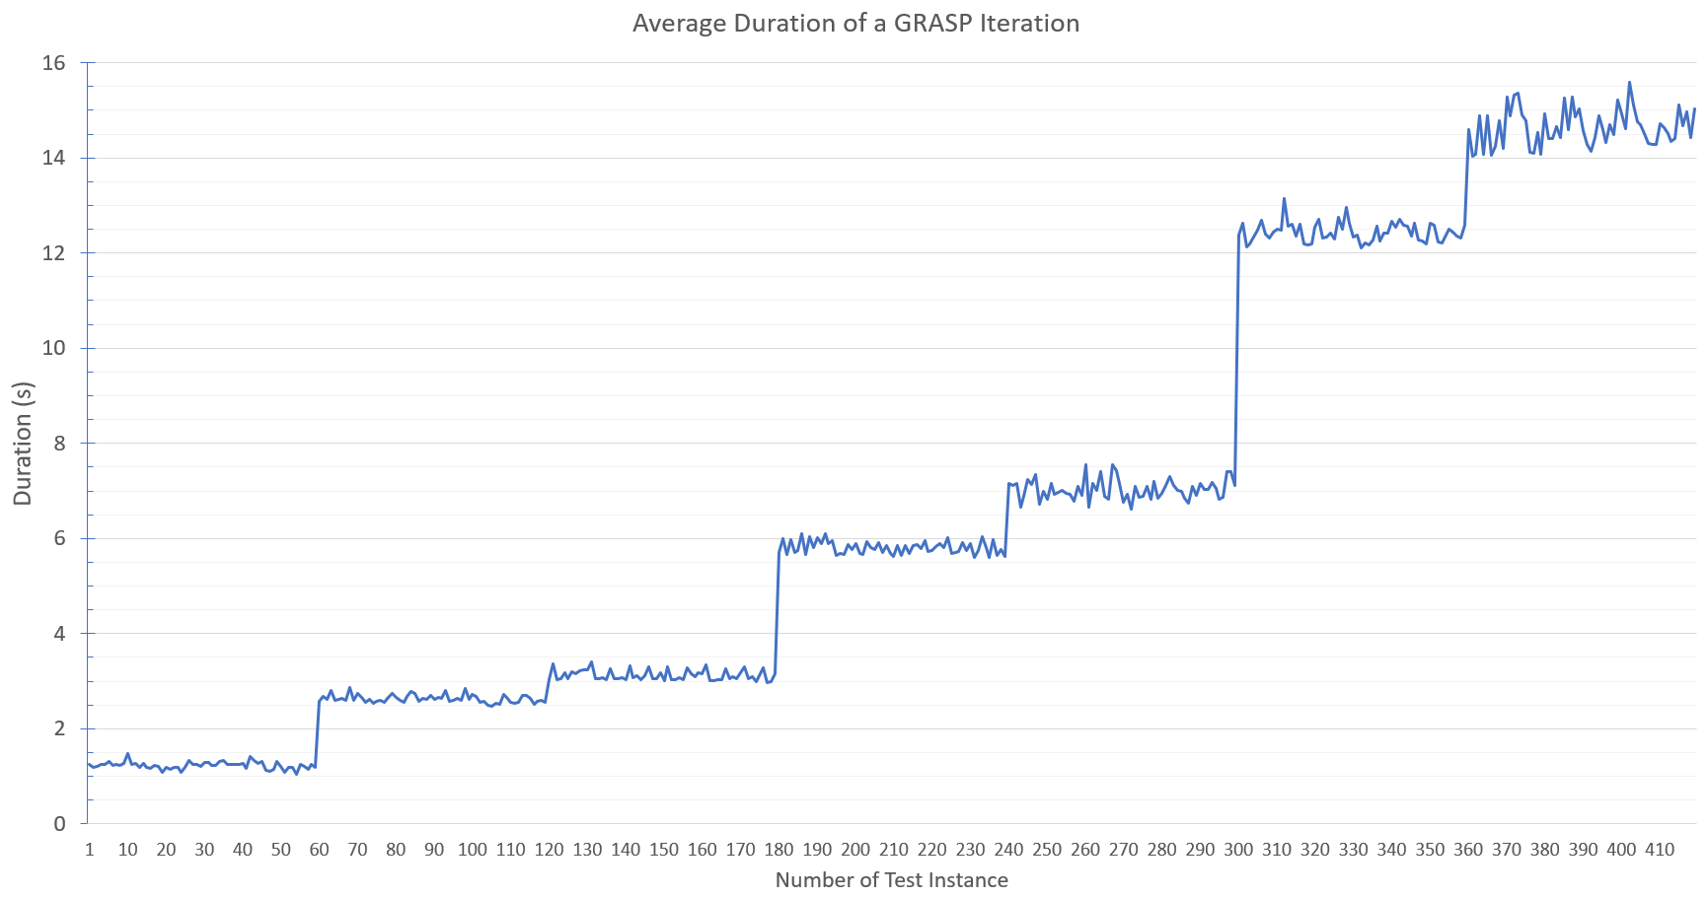
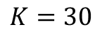
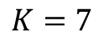
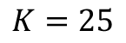
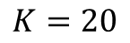
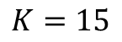
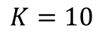
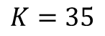
Execution time
Runs in under 5 minutes
Uses under 10 MB of RAM
Executable has 440 KB
$$K=35$$
$$K=30$$
$$K=25$$
$$K=20$$
$$K=10$$
$$K=15$$
$$K=7$$

Slide 18
Next Steps
Publish an article
Co-authored with prof. Nina Skorin-Kapov
Present the results
Spanish Ministry of Development (MITMA)

Slide 19
References
[1] K. T. Weber and R. Yadav, “Spatiotemporal Trends in Wildfires across the Western United States (1950-2019),” Remote Sensing, vol. 12, no. 18, 2020.
[2] Viking Air, “Viking’s Aerial Firefighter – Firefighting Technique.” https://aerialfirefighter.vikingair.com/firefighting/firefighting-technique. Accessed on: 2022-06-18.

Slide 20
Thank you!
github.com/LMesaric/MSc-Thesis-FER-2022

